Slide 1

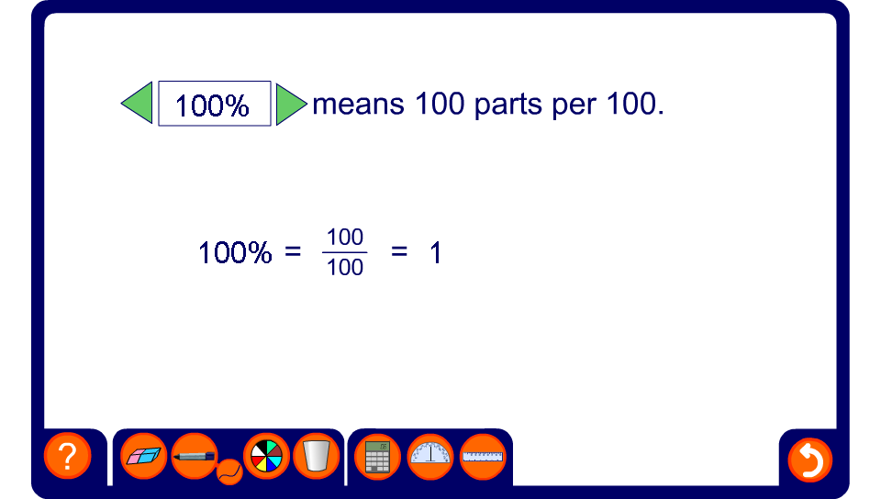


Percentages as fractions and decimals

